Slide 1





Proiect Budget Management
Team: Byte Karma
1. NITHYA PRAJWAL P
2. CAN/RUDH
3. BABA FAKRUDDIN
4. AKRAMVALI MS
5. ANURAG

Slide 2
Proiect Description
Obiectives
The primary objectives of this project are to develop a comprehensive budget plan, monitor spending, and identify potential cost savings opportunities.
Strategies
The team will employ various strategies, such as detailed forecasting, risk assessment, and regular budget reviews, to ensure the project stays financially on track.

Slide 3


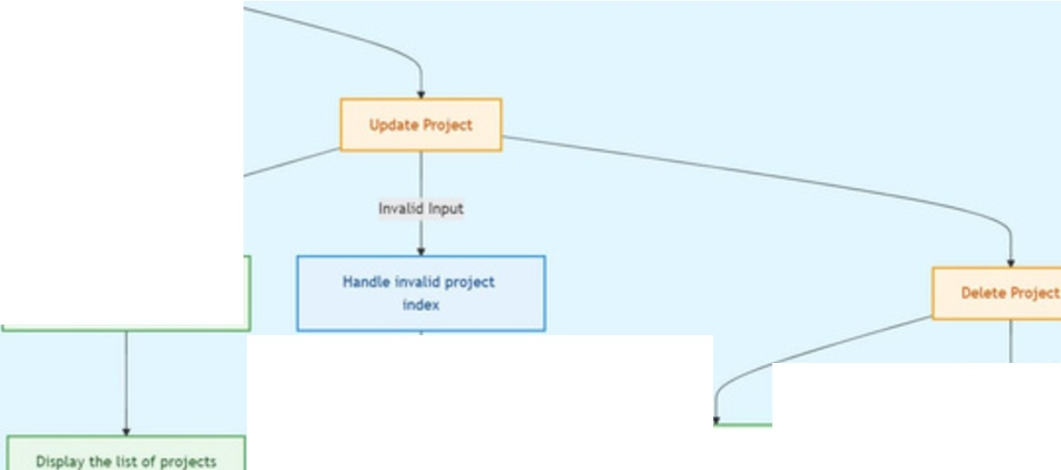






Cru.teProJtct
PrOff't)t ui.+r for pro)Kt
i.o.e1 tM 11st or projtcu from the JSON file
P\'ompt USM for ptO)Kt
«M1Cr'lptl0n
tt«a thfoueh the tin of
projtcU
Load the l1st of PfO}Kb from lht JSOU ftlA
---
ltwalk:lln,ut
PromptlMriflMbudtfl
hwnctiontd
Pl1nt the dttalb Ol hd'I proJ.«t
Ha,._ ir'rv.l1ld iftC)Ul ••t•,
lO.ld lN 111.l Of pro)KU frcmthtJS0Nf11•
Cl•iat• a IW'W Pro)Kt obJtcl wtth the prOYlded dttJlt1
H.,r.:,l• u.wWMl"lno
PfOJKbat• IOI.rid
Prompt tos.&ecttN PfOJ«t to updat•
Dnpla:, the list of projects
Hwlda. tnv,,hel w,put •·&·, non· indu
Add the MW" pro)Kt to tht It«.Of p,oJf<U
Prompt i.Mr to .tffl tiM Pf,OjtcttOCl44ttt
Sav• the te,d list of projtcU to JSOtl Ind CSV f!IH
RtffloYtlhtSf4Kttd PfO}Kt from the lHl
Prompt u-Ar f« new pro,ectdKcription
p,'OJ«U to,,J,S.O,tl 111d CSV tM 1.19d,ate4 11st of
Upd•t• the *tcttd
pro)t« II\ tht 11$1
Sa.... the upCIHtd lrl.t of PfO)tCUtoJS0tl1,ndCSV fffl

Slide 4




Project Budget Manager
Create a new project
View all projects
Update a project
Delete a project
Exit
Enter your choice (1-5): 1 Enter Project Name: Toy shop Enter Budget Required: 200000
Enter Project Description: kids to play,gift for lovers Is the budget sanctioned? (yes/no): no
Project added successfully.
Project Budget Manager
Create a new project
View all projects
Update a project
Delete a project
Exit
Enter your choice (1-5): 2
Project 1:
,
,
,
Name: Toy shop
"'"'--
"'-
"'-
Budget: 200000.0
Description: kids to play,gift for lovers
Sanctioned: No
Project Budget Manager
Create a new project
View all projects
Update a project
Delete a project
Exit
Enter your choice (1-5): 3
Project 1:
Name: Toy shop Budget: 200000.0
Description: kids to play,gift for lovers Sanctioned: No
Enter the project number to update: 1
Enter New Project Name: kids world Enter New Budget Required: 100000
Enter New Project Description: heaven for kids
Is the budget sanctioned? (yes/no): yes Project updated successfully.

Slide 5

Future Scope
,
,
Continuous ln,proven,ent
The team will continuously review and refine the budget management process, incorporating lessons learned and industry best practices.
'-
2
3
Automation and Di itization
Exploring innovative technologies to streamline budget tracking, forecasting, and reporting, increasing efficiency and transparency.
Expanded Services
Exploring opportunities to expand the team's expertise and services to support additional projects and clients in the future.

Slide 6
Thank You

